Slide 1


Crop Helper
IntelliDigest
Notes:
logo(?) title

Slide 2
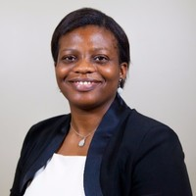
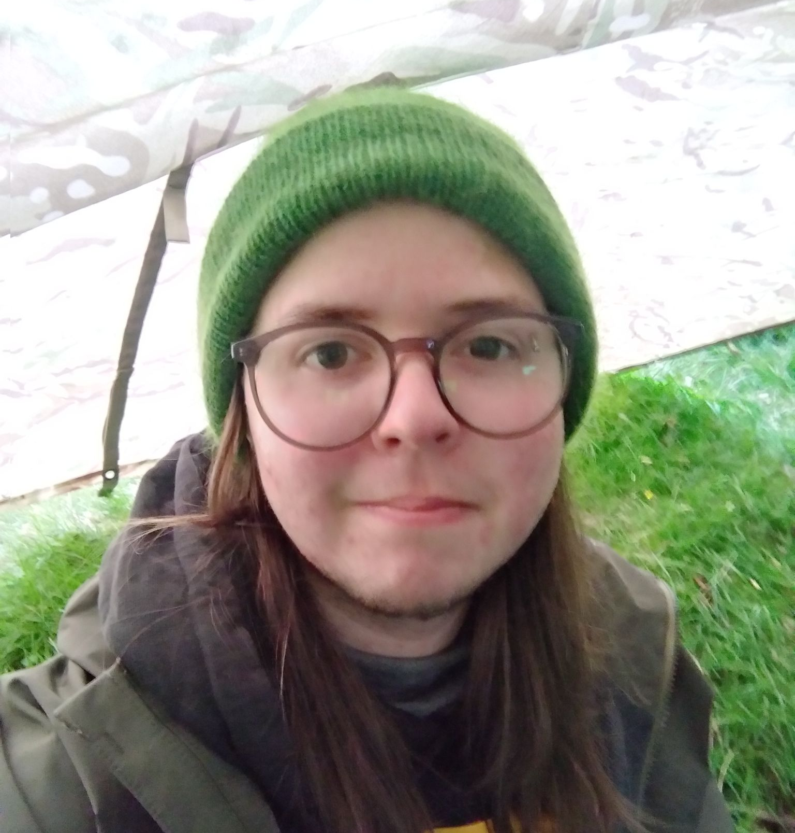


Meet The Team
Ifey Kanu
Michael Driscoll
Fraser McGuire
Callum Stewart
CEO
Software Developer
Software Developer
Systems Engineer
Notes:
Introduce everyone
Brief Explanation of company, values

Slide 3
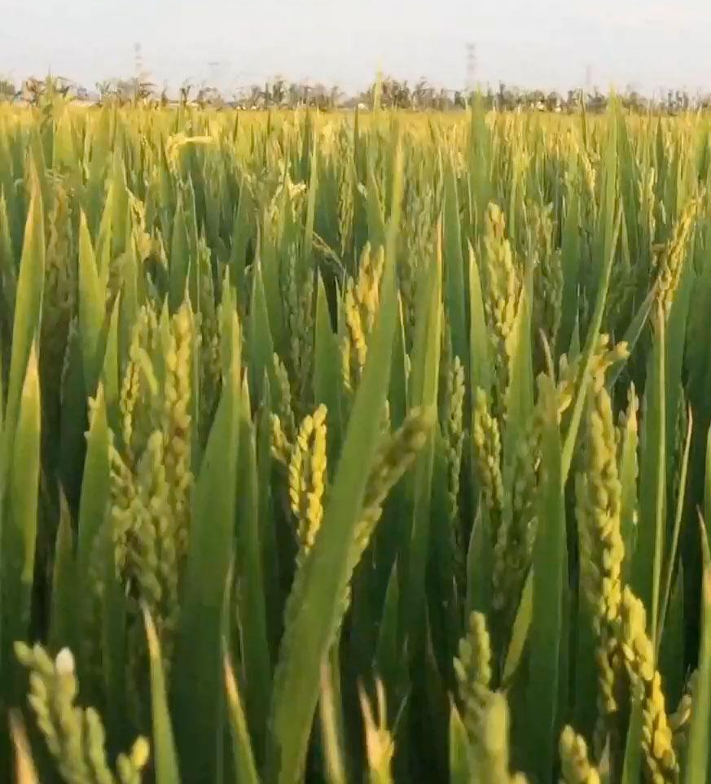
Sustainable Solution
Tailored to the Farmer
Optimising nutrient use
Only use necessary products
Supply and Demand
Maximise amount sold
Reduce waste
Limitations
Notes:
Discuss the problem
Process, limitations, linking to intellidigest ecosystem
Premise;
Not just thinking about a solution to a problem, but a sustainable one
Want to work with our current research and app, so suggested crops will be based off of the supply and demand of that region
Want to avoid using blanket fertilisers and pesticides, give suggestions based off of the farmers soil type, the crop growing there, and the specific pest given by feedback from the farmer. Together this will encourage a better yield.

Slide 4


App Prototype
Notes:
Android app- 98% android in india (developing makes sense)
(highlight again that app is an addition to pre-existing platform)
Functions;
Allows users to submit crop data and receive suggestions on fertilizers. The user can also submit pest information and receive pesticide suggestions.
App will show a cost breakdown of crop seed, fertilizer, and pesticide, alongside showing an estimated yield and current market price (Most of this is hardcoded due to time constraints).
Image demonstrations
The login page connects the user to the intellidigest food-loss and waste tracker app. The demonstration application is just one facet of the pre-existing platform.
When a user enters a crop, an API call is made, which returns fertilizer and pest data specific to said crop.
The user can then select values from these fields, and when the pest field is filled, a second api request is made to find appropriate pesticides to match both crop and pest.
Finally, the user can select a pesticide and then press submit to get a cost breakdown.
The cost breakdown is mostly hardcoded for this demonstration, however, with more datasets to draw from, this information could be quickly and accurately displayed to the user.

Slide 5
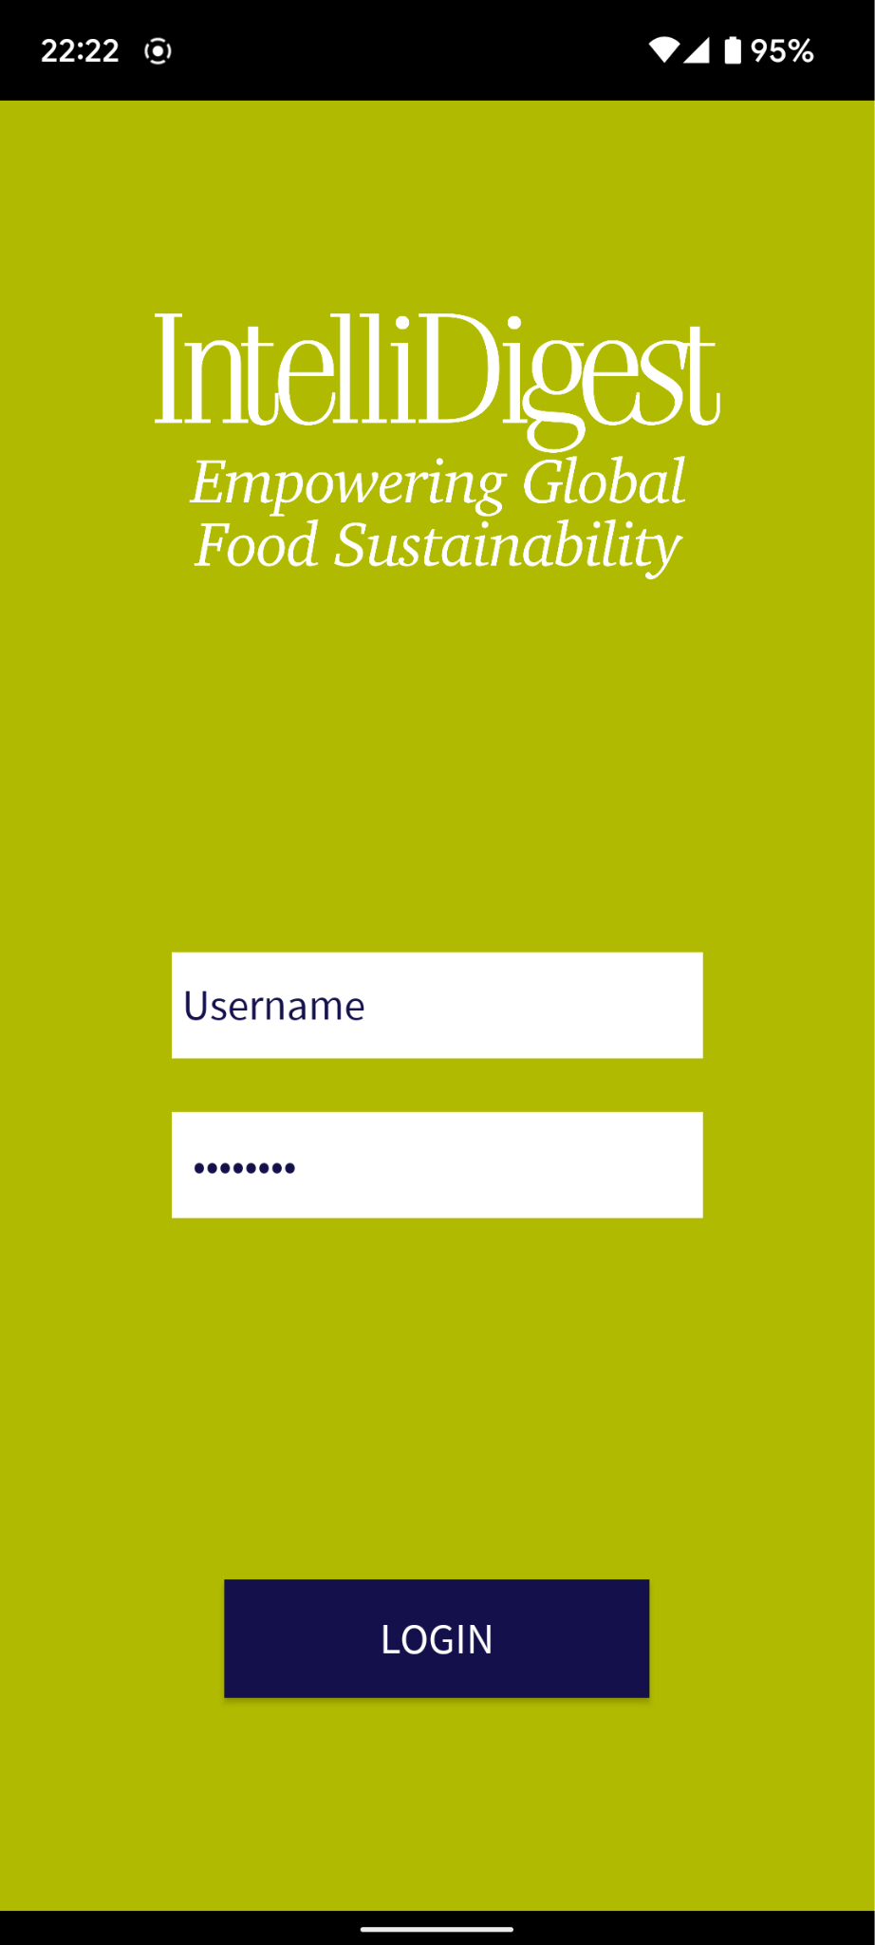
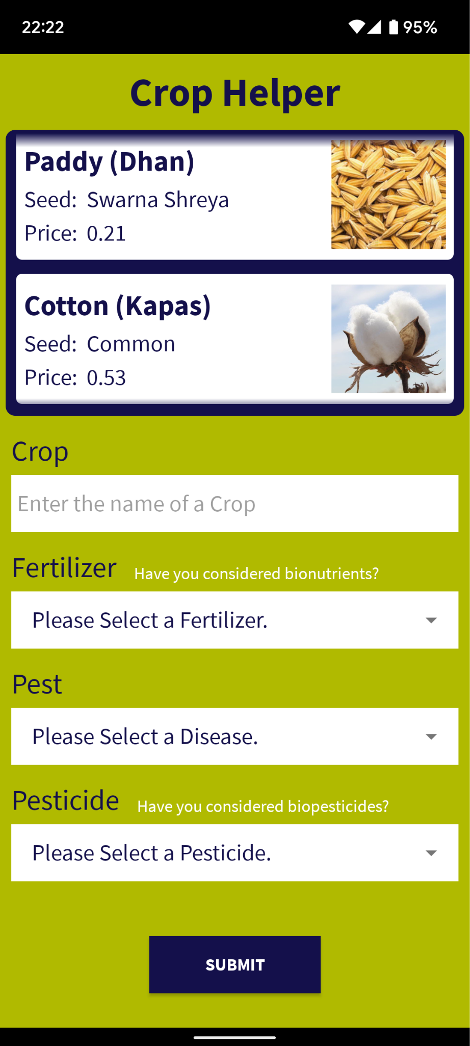
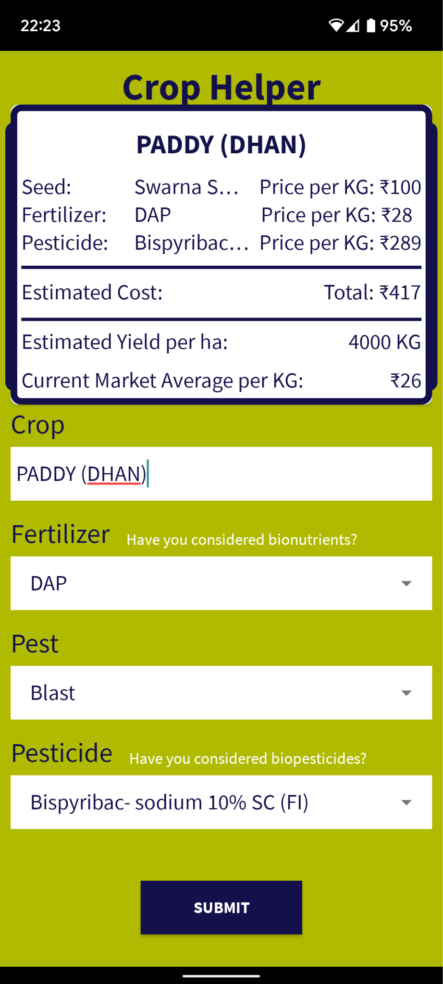
App Prototype
Notes:
Android app- 98% android in india (developing makes sense)
(highlight again that app is an addition to pre-existing platform)
Functions;
Allows users to submit crop data and receive suggestions on fertilizers. The user can also submit pest information and receive pesticide suggestions.
App will show a cost breakdown of crop seed, fertilizer, and pesticide, alongside showing an estimated yield and current market price (Most of this is hardcoded due to time constraints).
Image demonstrations
The login page connects the user to the intellidigest food-loss and waste tracker app. The demonstration application is just one facet of the pre-existing platform.
When a user enters a crop, an API call is made, which returns fertilizer and pest data specific to said crop.
The user can then select values from these fields, and when the pest field is filled, a second api request is made to find appropriate pesticides to match both crop and pest.
Finally, the user can select a pesticide and then press submit to get a cost breakdown.
The cost breakdown is mostly hardcoded for this demonstration, however, with more datasets to draw from, this information could be quickly and accurately displayed to the user.

Slide 6
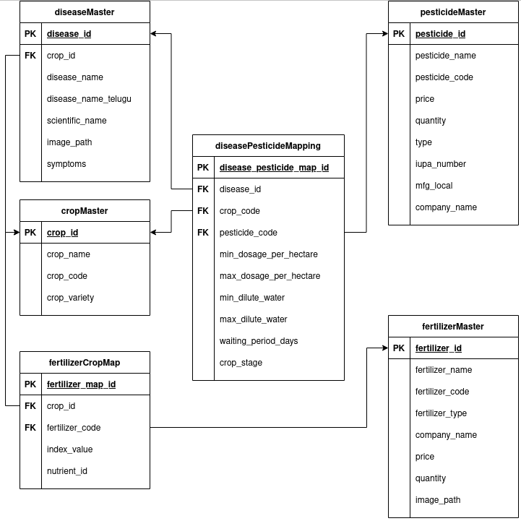
The API
We implemented an API that combined the agronomic data to provide useful suggestions to farmers regarding their choice of pesticides and fertilisers
Handles the business logic of the mobile app
Some of the data is incomplete
There are many avenues that could be explored with larger and more varied datasets
Leverages the power of Google Cloud Platform with Cloud Run and BigQuery
Notes:
The data we are using;
Crop Data
Fertilizer Data
Pesticide Data
Disease/Pest Data
DIsease/Pest Mapping
Fertilizer Mapping
(location based soil data??)
For a fully functioning system the datasets will need to be up-to-date and from a wide range of sources to improve accuracy.
Limitations;
Datasets linking crops-fertilizer pest-pesticide incomplete
Are we able to get soil data based on location, is this something we have to ask farmers to supply?

Slide 7
API Routes
Notes:
The data we are using;
Crop Data
Fertilizer Data
Pesticide Data
Disease/Pest Data
DIsease/Pest Mapping
Fertilizer Mapping
(location based soil data??)
For a fully functioning system the datasets will need to be up-to-date and from a wide range of sources to improve accuracy.
Limitations;
Datasets linking crops-fertilizer pest-pesticide incomplete
Are we able to get soil data based on location, is this something we have to ask farmers to supply?

Slide 8

Benefits
Maximise Farmer Profits
Optimised Nutrient Use
Demand
Drives
Supply
Sustainable Practices
Notes:
“Benefits of app to farmer and greater potential of the app as a tool to enhance sustainability by ensuring that demand drives supply while optimising nutrient use in the soil through data insight”~Ifey
Maximise farmer profits
Demand drives supply
Optimised nutrient use cares for soil, maximises yield
Encourage sustainable practices

Slide 9
Moving forward….
Funding
Further Actions
More research, more data
Database
Cloud Hosting
Speak to Experts
QR Tracking
Bionutrients
Improve in the next 4 weeks
Notes:
Fleshing out
Acquire datasets etc
information will also need to be confirmed by experts in the field of farming since we are not fully knowledgeable on the subject of fertilizers and pesticides
(provide info on bionutrients?)

Slide 10
Questions?

